Slide 1
Extracting data from an Excel file with the concept of field value.
GROUP 3

Slide 2
MEMBERS AND THEIR CONTRIBUTIONS:-
Piyush Kumar(13000219124) :- Research for module used and help in code.
Sejal Agarwal(13000219106) :- Writing the source code.
Anurag Adarsh(13000219122) :- Framing the contents of Project Report.
Pratyush Chand(13000219103):- Preparation of the Project Report.
Vishal Kumar Jha(13000219136):- Preparation of the Project PPT.

Slide 3
PROJECT OVERVIEW:-
The project requires extraction of data from a given excel file using the concept of field value
Using the concept of field value implies that the corresponding fields and their respective values will exist side by side in the excel file
Excel sheets are a very intuitive and user friendly way to manipulate large data sets
The idea behind the project is to ease the accessibility of data while working with excel files. Programmatically accessing the data proves beneficial as it allows to bring data from multiple sources into a single program
The project extracts and reads data from the provided excel sheet

Slide 4
SOFTWARE DEVELOPMENT CYCLE
This first stage comprised of the analysis and planning for the requirements of the project.
SOFTWARE DEVELOPMENT CYCLE
PLANNING AND ANALYSIS
DESIGNING THE FUNCTIONS
BUILDING THE PROJECT
TESTING THE PROJECT
DEFINING REQUIREMENTS
The final stage comprised of testing the project with the test cases from sample sheet.
The second stage comprised of structuring the requirements and finalising the working methodology.
The fourth stage comprised of using all the functions and writing the final source code.
The third stage comprised of deciding the modules and framing the user defined functions to be used in the project.

Slide 5
Modules Used :-
Pandas :-
Pandas is a python library used to analyze data and to work with data sets
It has functions for analyzing, cleaning, exploring and manipulating data
The name “Pandas” has a reference to both “Panel Data”, and “Python Data Analysis”
Sys :-
The sys module provides functions and variables used to manipulate different parts of the Python runtime environment
Furthermore, the sys module provides information about constants, functions and methods of the Python interpreter

Slide 6
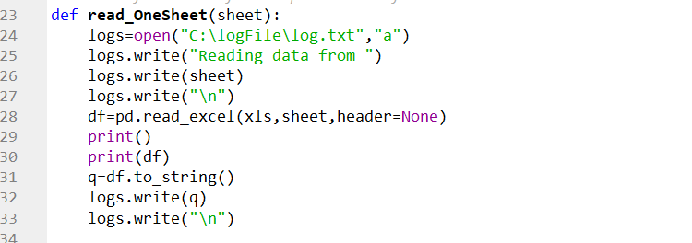
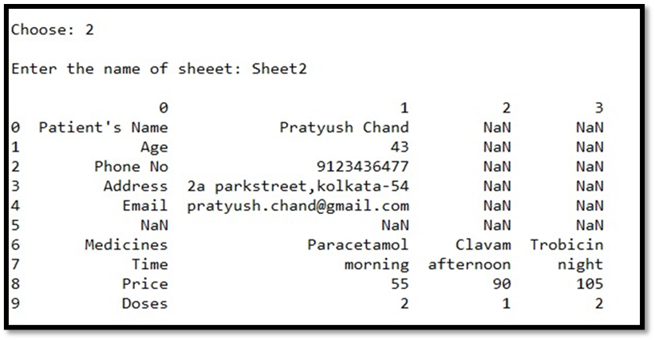
Functions Used :-
read_OneSheet()function to read data from one sheet using a DataFrame object and store it in a log file.
Execution screenshot of the read_OneSheet() function.

Slide 7
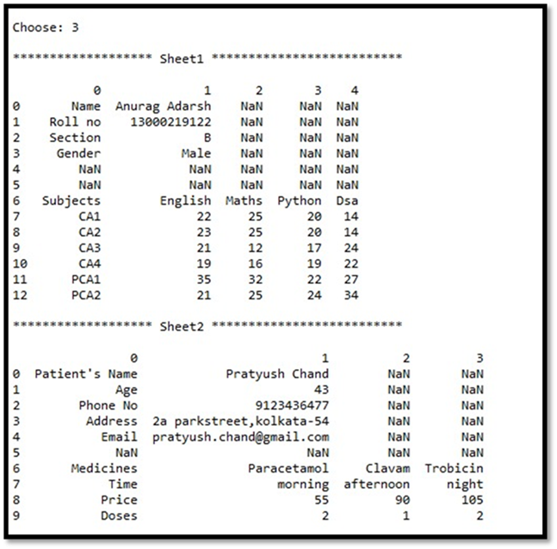
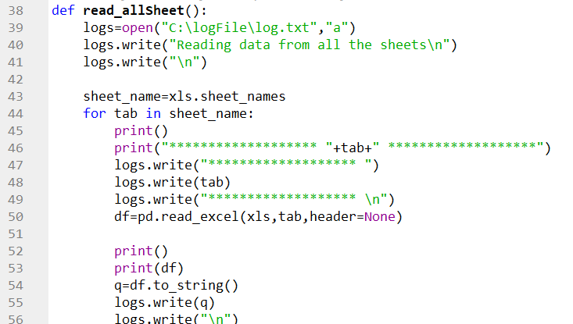
read_allSheet() function to read data from all the sheets using a DataFrame object inside a for loop and store it in a log file
Execution screenshot of the read_allSheet() function

Slide 8
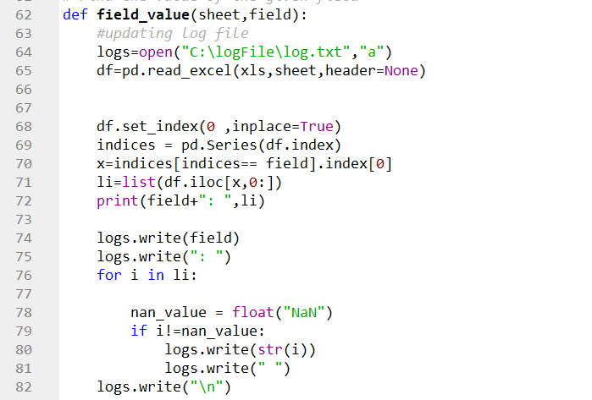
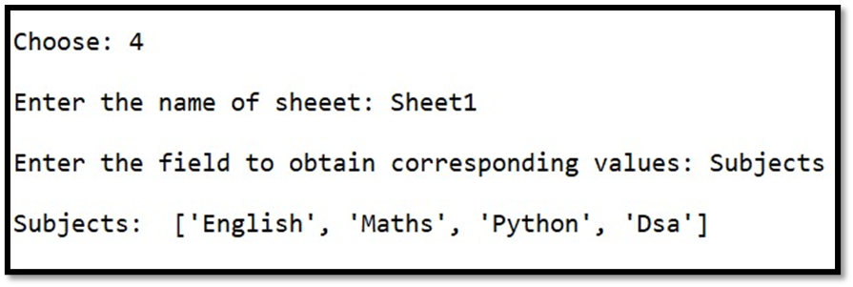
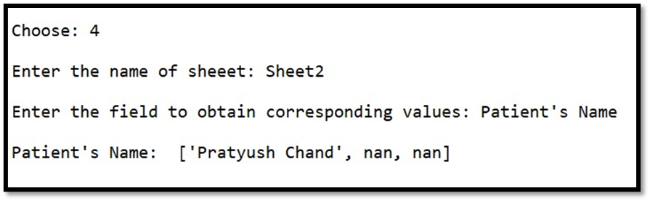
field_value()function to firstly read the sheet data into a DataFrame object and then using the set_index() and Series() methods to store and print the values of the field entered by the user and store in log file.
Execution screenshot of the field_value() function.

Slide 9
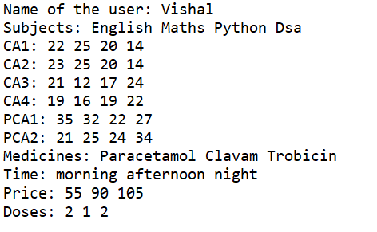
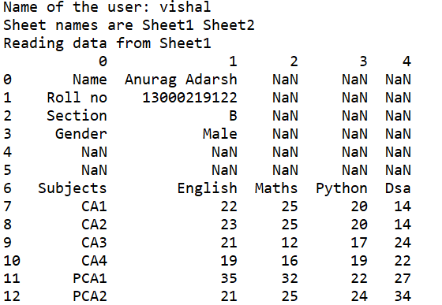
LOG FILE DATA STORAGE
Storage of data in the log file after extraction from the excel file.

Slide 10
REFERENCES: -
1) https://wiki.python.org/moin/
2) https://www.w3schools.com/python/
3) https://www.geeksforgeeks.org/python-pandas-dataframe-set_index/
4) https://stackoverflow.com/questions/35818873/pandas-series-creation-using-dataframe-columns-returns-nan-data-entries

Slide 11
CONCLUSION:-
The project was completed successfully using different modules of python .
While working with the project, we became familiar with various new modules of Python and the methods and benefits of using those modules.
The project provided us with an opportunity to add to our knowledge of Python as a Programming Language.
- Thank You

